Slide 1
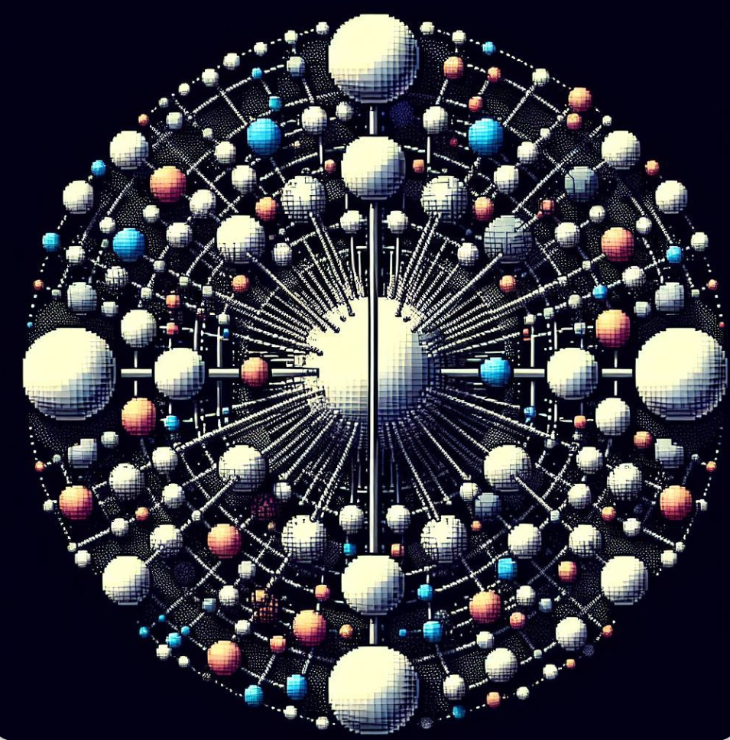

Form factors of particle systems in dilute solutions
Munirat Idris
250998407

Slide 2
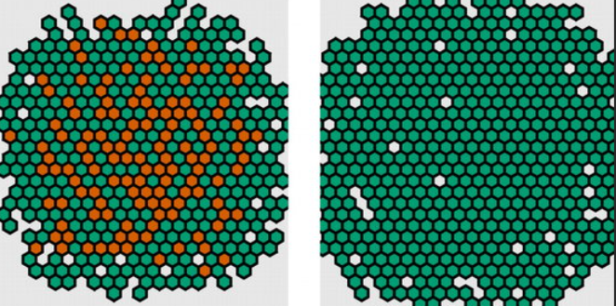
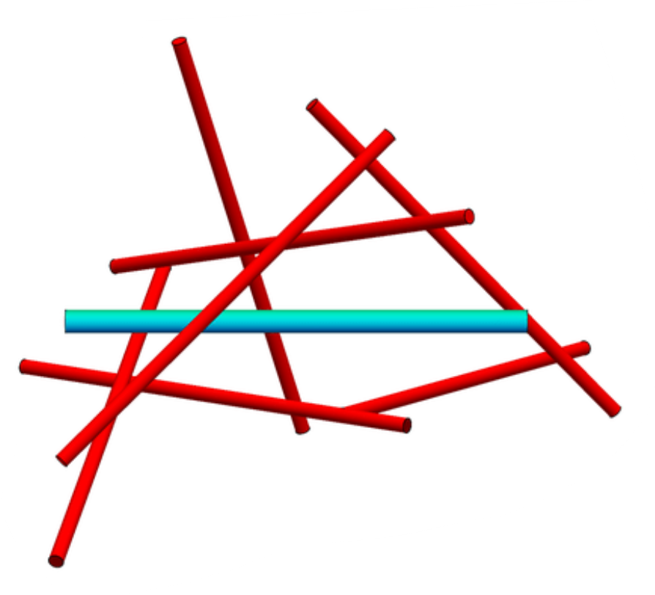
Introduction
Scattering experiments involve probing the structure and properties of particles or waves by observing how they scatter off-targets or interact.
Particle systems are the mathematical and computational models used to simulate the behaviour of a collective of particles, such as atoms or photons, in a given physical environment
In static light scattering experiments, form factor is crucial by describing how individual particles scatter light intensity

Slide 3
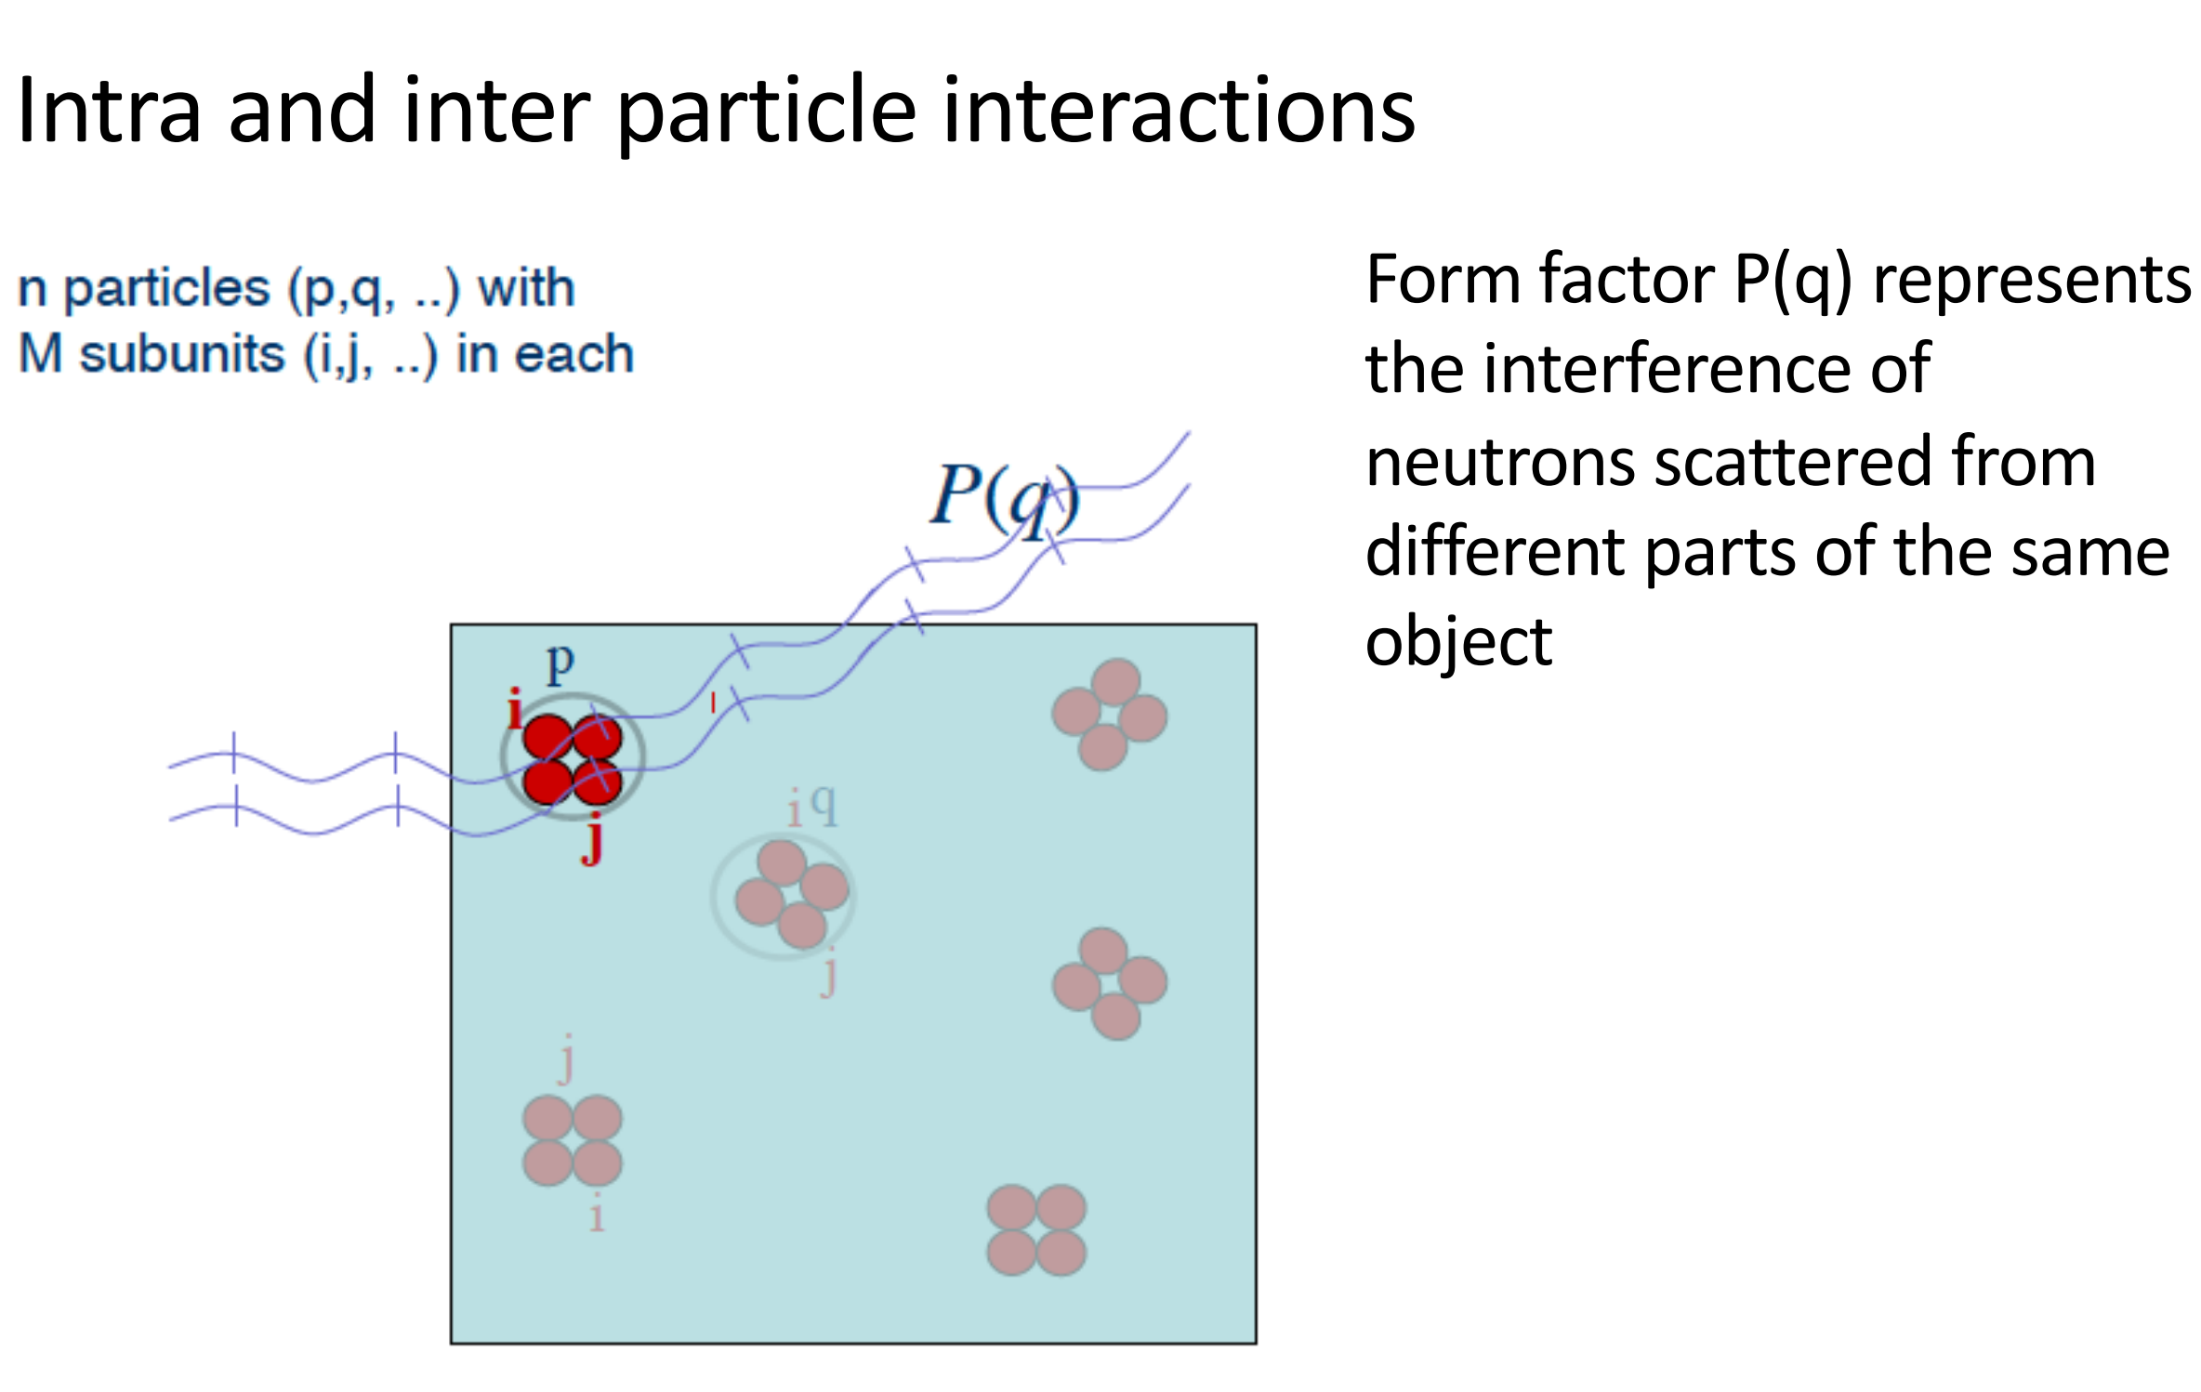
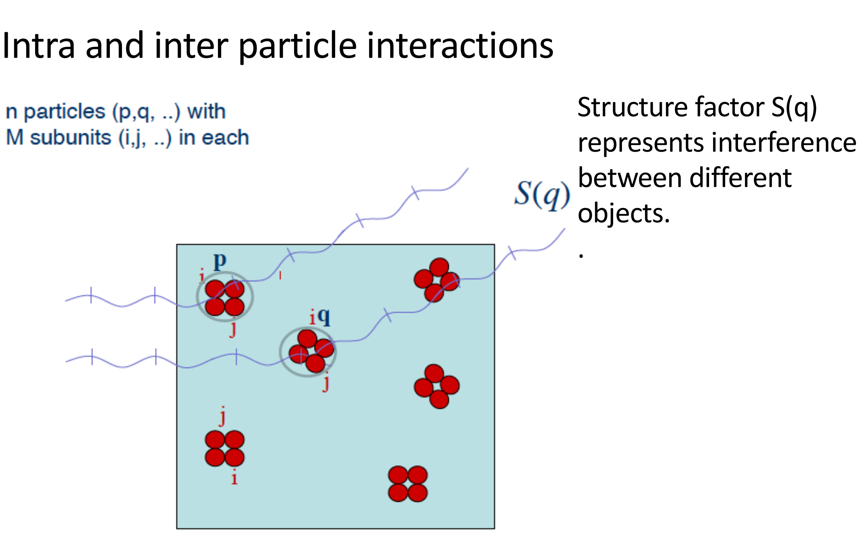
Intra and inter-particle interactions
The form factor P(q) describes the scattering from a single particle, which strongly depends on its size and shape.

Slide 4
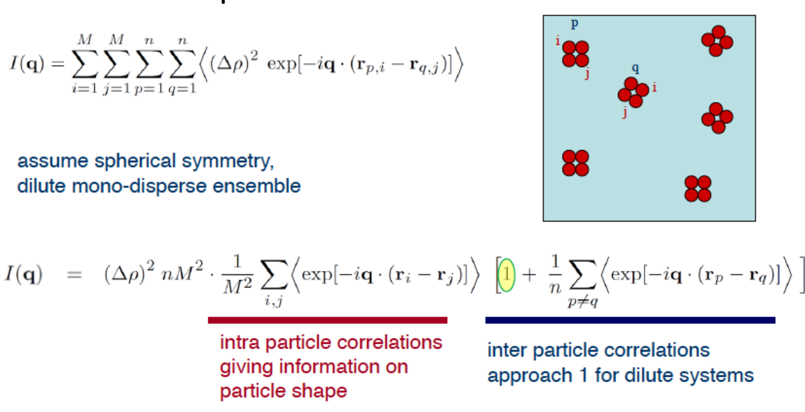
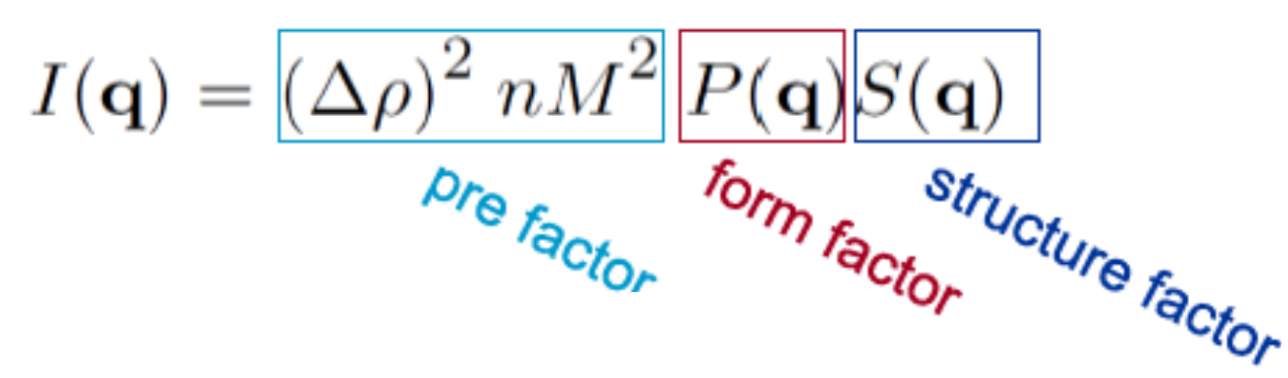
Intra and inter-particle interactions in a system

Slide 5

Objective of this study
This study focuses on the potential of light scattering to understand different particle shapes and analyze their physical and statistical properties. Because we are working with dilute solutions, we emphasize only the form factors.
I utilized Python for data analysis. The code is meticulously designed to generate simulated data and perform statistical characterization, thereby advancing our understanding of complex particle systems

Slide 6

Theoretical models of form factors for particle systems

Slide 7
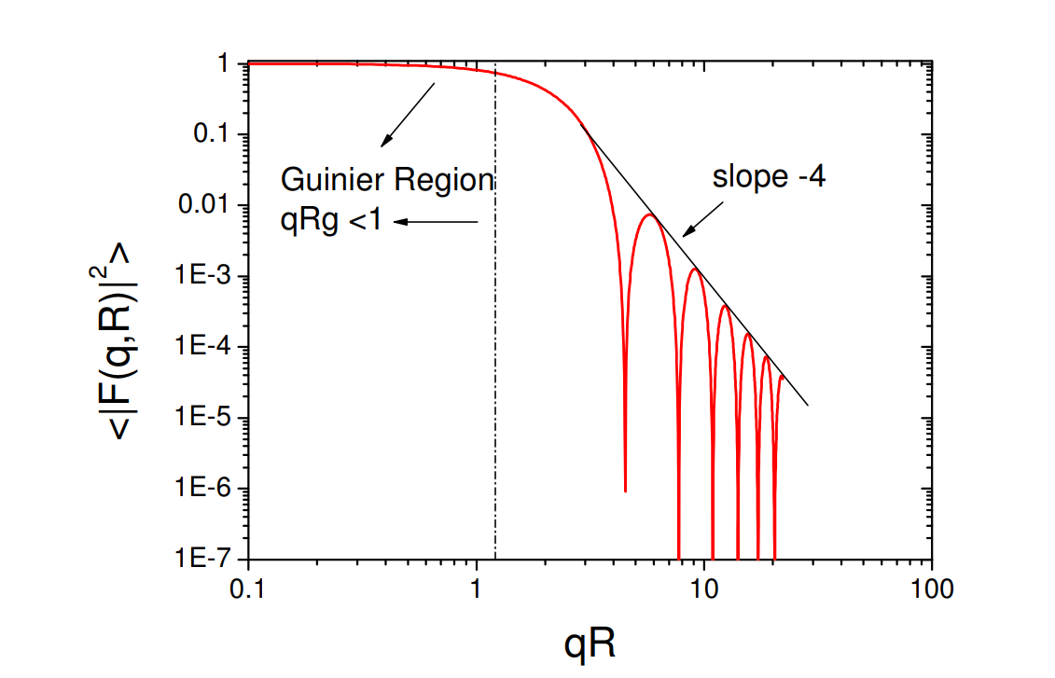
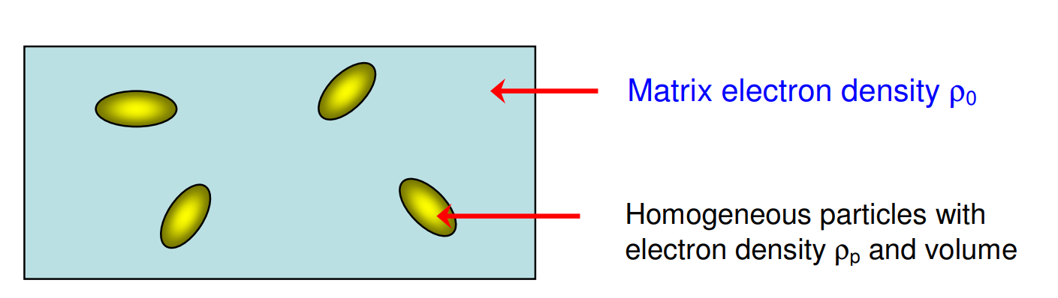
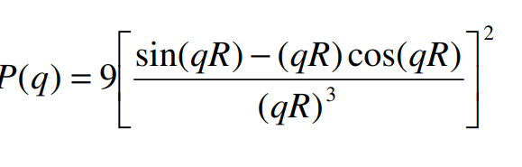
Form factor of a sphere
Schematic drawing for “dilute” particles suspended in a homogeneous matrix.

Slide 8
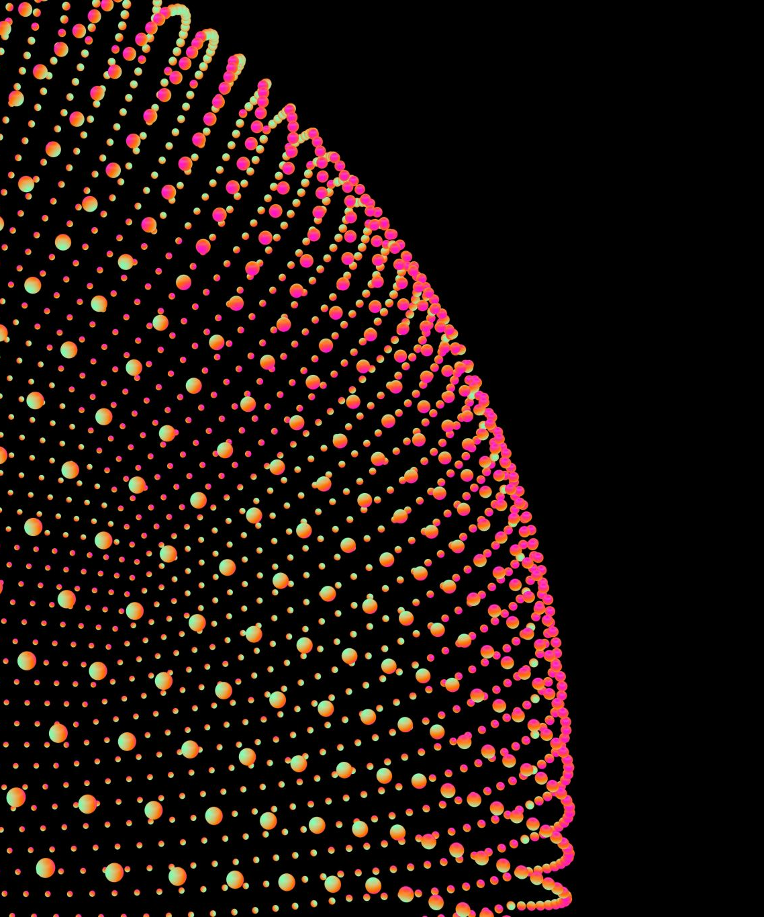
Monodisperse spherical particle system
Monodisperse spheres are identical in size and shape

Slide 9
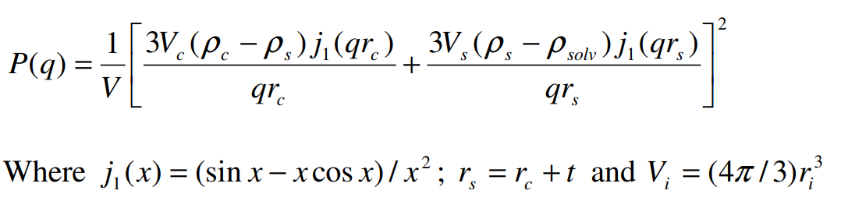
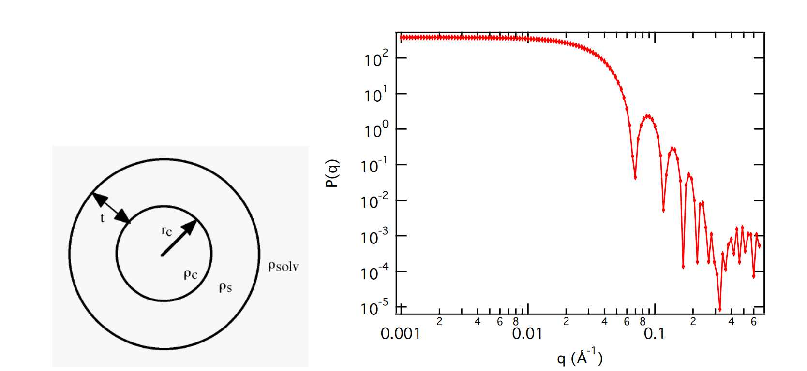
Form factor for Monodisperse spherical particle
monodisperse spherical particle with a core-shell structure

Slide 10
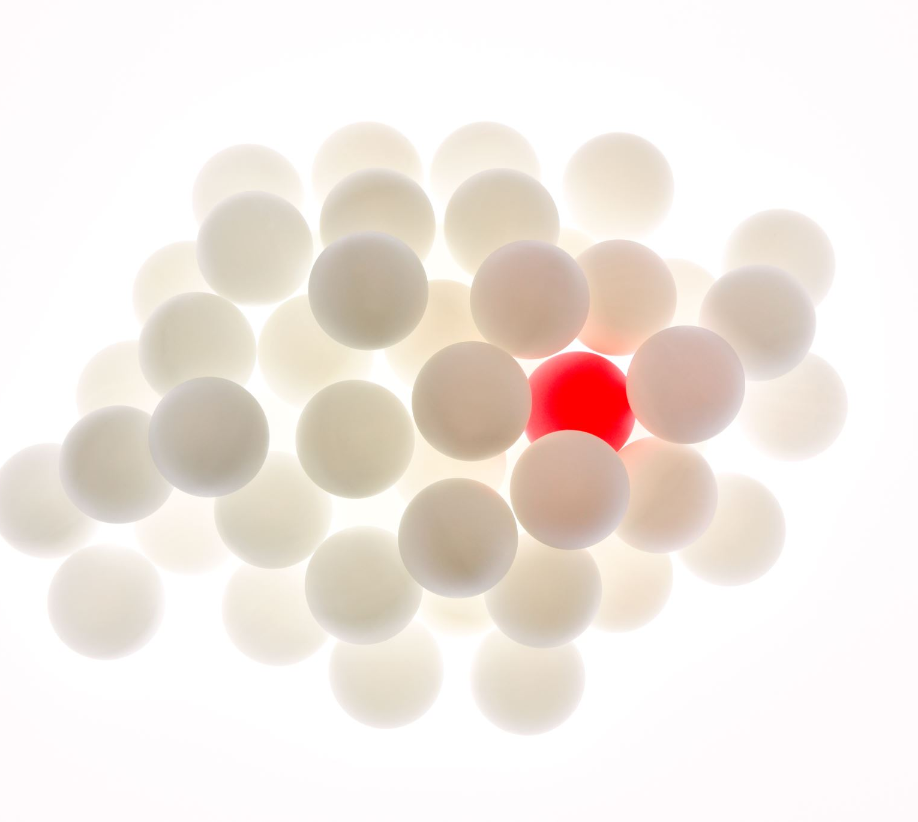
Bidisperse spheres particle system
Calculates the scattering for a bidisperse population of spheres with uniform scattering length density.
The Intensity is normalized by the average particle volume
F is the scattering amplitude of a sphere

Slide 11
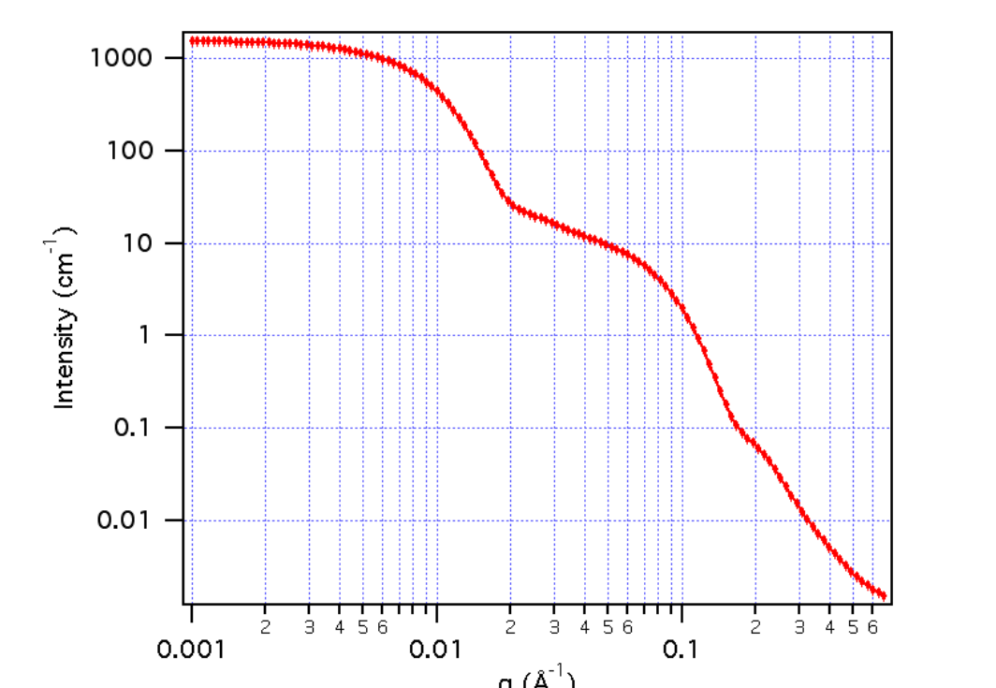
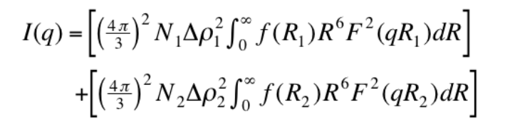
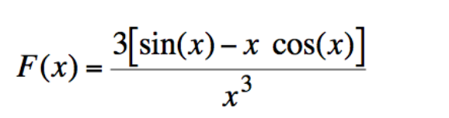
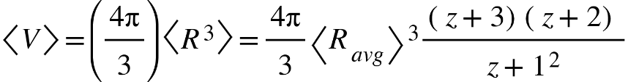
Form factor of bidisperse system

Slide 12
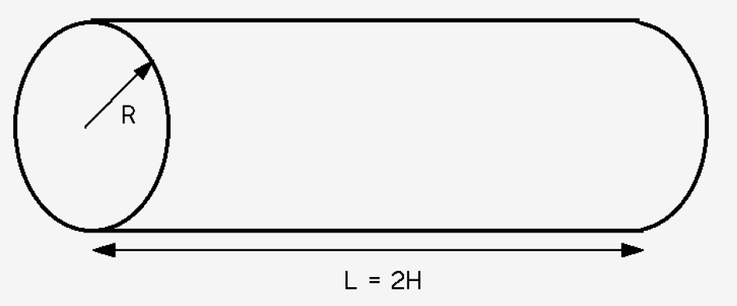
Cylindrical rods
Monodisperse right circular cylinder with uniform scattering length density.
The form factor is normalized by the particle volume such that P(q) is an average over all possible orientations of the cylinder
The scale and scattering length densities (the contrast) are both multiplicative factors in the model and are perfectly correlated

Slide 13
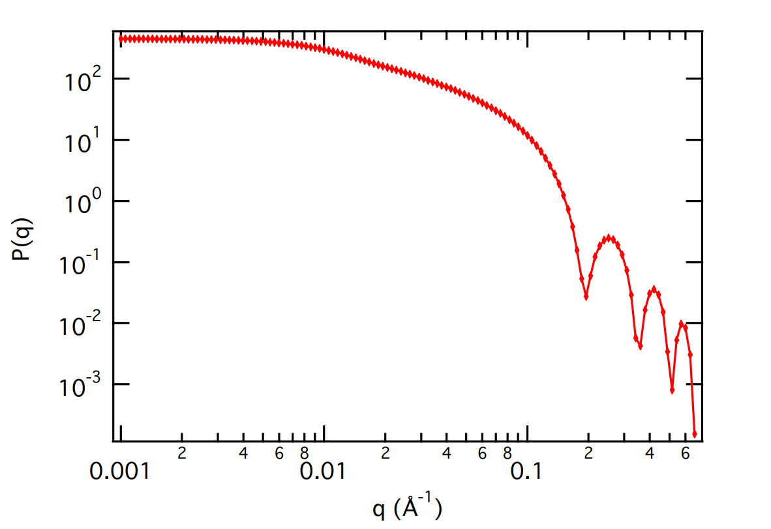
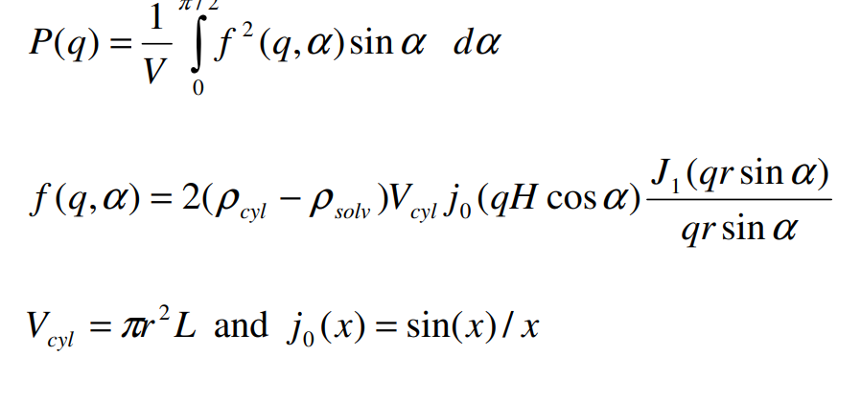
Form factor for cylindrical rods
Monodisperse Rigid Cylinders (a simple model for DNA)

Slide 14
Methodology
Statistical characterization
Python software

Slide 15
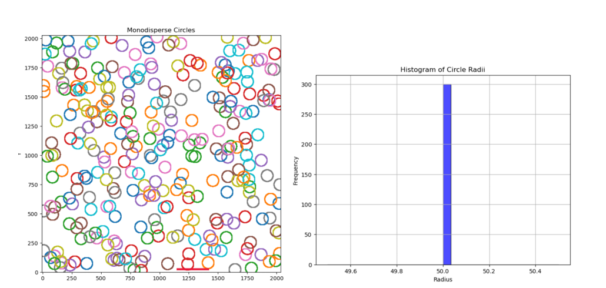
Results
Monodisperse spheres
The histogram typically shows a single, sharp peak, indicating uniformity in particle size
Skewness is near zero in ideal monodisperse systems

Slide 16
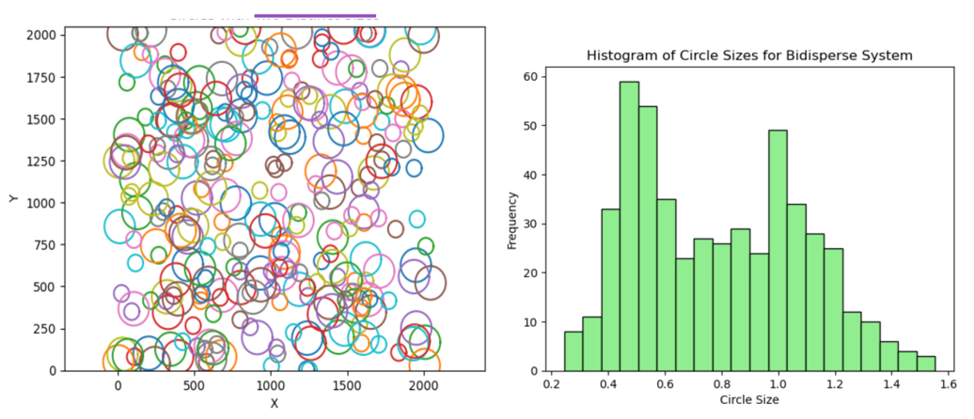
Bidisperse spheres
Mean | 73.17
Standard deviation | 24.93
Variance | 621.64
Skewness | 0.15
sizes are equally represented,
exhibit low skewness

Slide 17
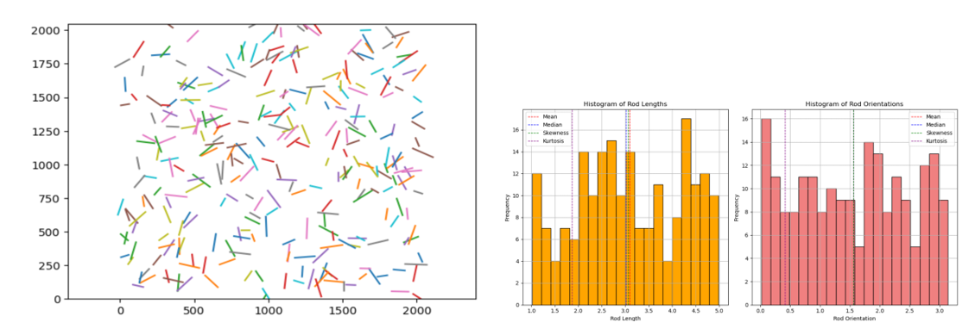
Cylindrical rods
The length distribution histogram can reveal whether the system is monodisperse, with uniform-length rods, or polydisperse.
The orientation distribution, depicted in a polar histogram, indicates the directionality of rods within the system.
 | Rod length | Rod orientation
Mean | 3.09 | 1.56
Standard deviation | 1.13 | 0.93
Variance | 1.27 | 0.87
Skewness | -0.03 | 0.00
Median | 3.02 | 1.56
Kurtosis | -1.09 | -1.23

Slide 18
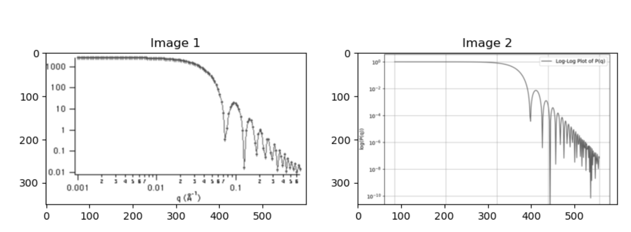
Structural Similarity Index Measurement (SSIM) for a sphere
Theoretical
Calculated

Slide 19
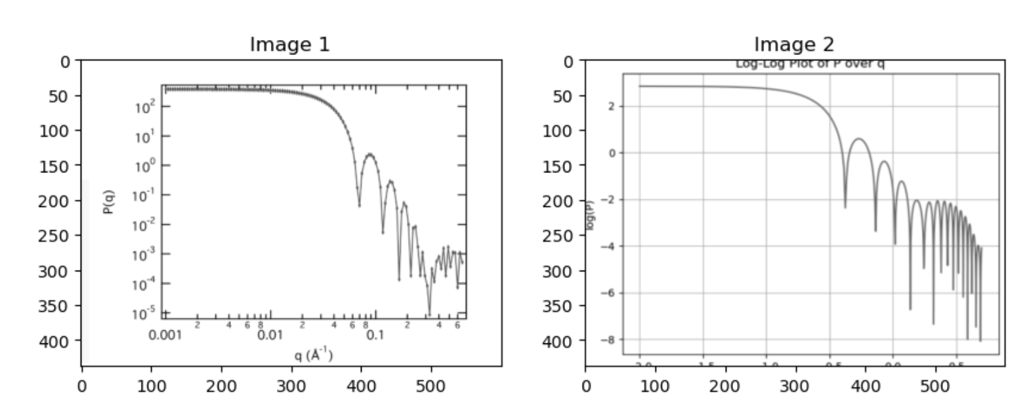
Monodisperse hardcore sphere
Theoretical
Calculated

Slide 20
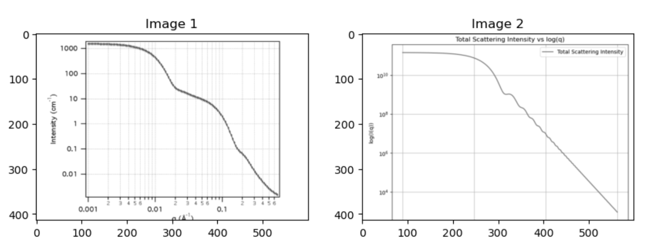
Bidisperse particle system
Theoretical
Calculated

Slide 21
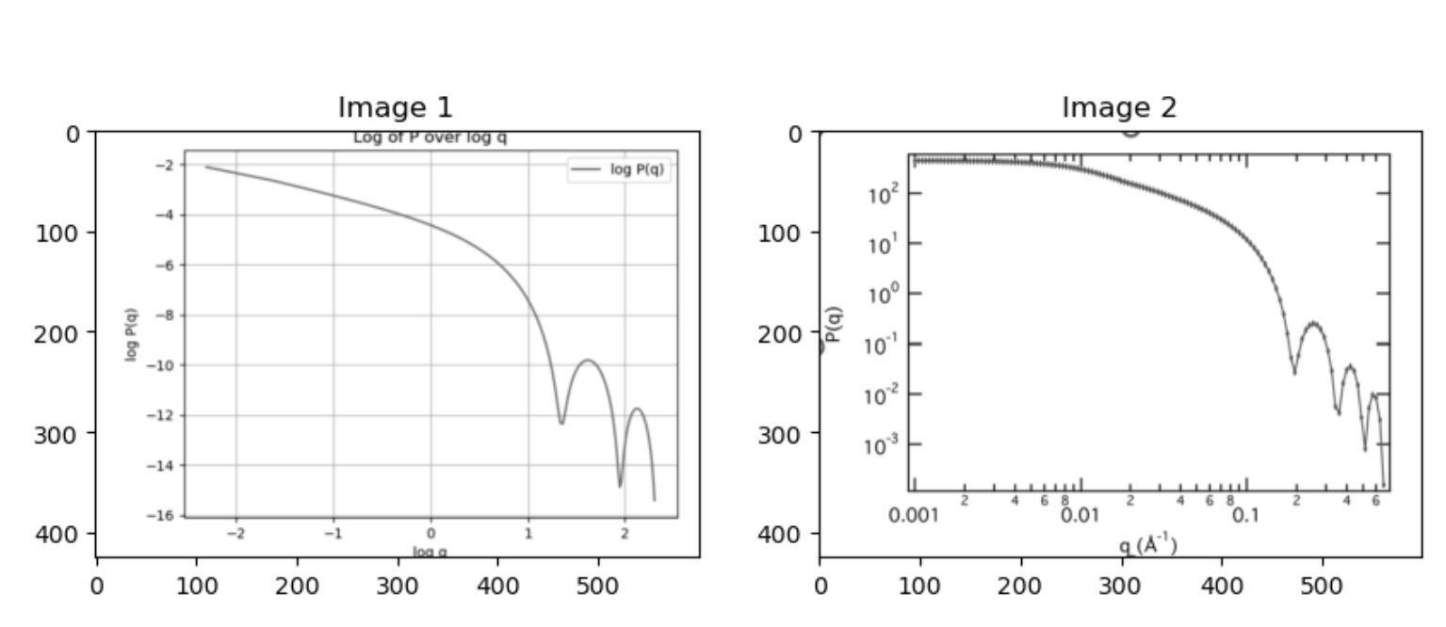
Cylindrical rod with uniform scattering length
Calculated
Theoretical

Slide 22
Comparison of particle system error
Particle systems | Hard sphere | Monodisperse spheres | Bidisperse sphers | Cylindrical rod
Least square error | 3.90e¹⁰ | 4.88e⁻⁸ | 2.36e²⁴ | 9.49e⁻¹⁰
Standard error | 9.886e⁻⁷ | 9.881e⁻⁶ | 7.68e¹⁰ | 9.74e⁻⁷
SSIM | 0.72 | 0.71 | 0.69 | 0.73
Mean squared error | 0.01 | 0.02 | 0.01 | 0.01
Standard deviation | 0.11 | 0.13 | 0.10 | 0.12

Slide 23
Discussion
All particle system were randomly distributed
All calculated form factors were in close agreement with the theoretical values except for the bidisperse particle system
SSIM values were similar with all the particle systems considered
The form factors are instrumental in characterizing particles Their understanding advances our ability to tailor materials for specific applications

Slide 24
Conclusion
Form factors for monodisperse spheres provide data on the uniformity and precision of particle sizes within a sample. The sharpness of the scattering peak can indicate the degree of uniformity
For bidisperse systems, the presence of two distinct particle sizes adds complexity, requiring careful analysis of form factors to distinguish between the different populations of spheres.
The form factor of cylindrical rods reveals their anisotropic properties, which are paramount in designing materials with directional dependencies

Slide 25
Selected References
Bohren, C. F., & Huffman, D. R. (1983). *Absorption and Scattering of Light by Small Particles*. Wiley.
Luisi, P. L., Walde, P., & Oberholzer, T. (2000). Lipid vesicles as possible intermediates in the origin of life. *Current Opinion in Colloid & Interface Science*, 5(1-2), 40-52.
Teraoka, I. (2002). *Polymer Solutions: An Introduction to Physical Properties*. Wiley
Odijk, T. (1986). *Theory of lyotropic polymer liquid crystals.* Macromolecules, 19(8), 2313-2329.
Onsager, L. (1949). *The effects of shape on the interaction of colloidal particles.* Annals of the New York Academy of Sciences, 51(4), 627-659.

Slide 26

Any Questions?

